Slide 1

8
AI-POWERED PERSONALIZED ENVIRONMENTAL HEALTH ADVISORY SYSTEM USING IOT
Submitted by
Guided by
M.Jagan 23619116
S.Mohamed abrar 23619121
R.Parthasarathy 23619127
S.J Kavitha M.E,(Ph.D)
Assistant professor
Mr. Akash
Assistant professor

Slide 2
ABSTRACT
Air pollution continues to be one of the most serious environmental and public health problems in the world, impacting millions of people. Poor air quality increases the risk for vulnerable populations including children, the elderly, pregnant women and persons with respiratory or cardiovascular disease. Current air quality monitoring systems usually report levels in terms of the Air Quality Index (AQI) which is difficult for the general public to interpret and does not provide personalized health advice. The project is an AI-Powered Personalized Environmental Health Advisory System Using IoT which will continuously monitor the environmental conditions and provide customized health advisories based on the health profile of the user. The system will be built around an ESP32 microcontroller, equipped with a PMS5003 (PM2.5/PM10), MQ-135 gas sensor, DHT22 temperature and humidity sensor, and a GPS module for real-time environmental data collection. The collected data is sent to the cloud platform through Wi-Fi, where an AI model analyzes the sensor readings and produces an Environmental Health Risk Score (EHRS). The system produces personalized health recommendations based on the EHRS and the user’s chosen health profile. These include the safety of staying in the present location, how long to remain there and precautions to take. The aim of the system is to generate user-specific health guidance from complex air quality data, which is easy to interpret, so that vulnerable individuals can make informed decisions and reduce their health risks from exposure to air pollution.

Slide 3
Problem statement & objectives
Problem Statement
Current air quality monitoring systems mainly show AQI values, which can be difficult for normal people to understand. They also do not give personalized health advice based on a person's health condition and location. Therefore, there is a need for a smart system that can monitor air pollution in real time, calculate the health risk, and provide simple personalized recommendations to help people stay safe.
Objectives
Monitor air quality in real time using IoT sensors.
Measure harmful pollutants such as PM2.5, PM10, and gases.
Track the user's location using GPS.
Use AI/ML to calculate the Environmental Health Risk Score (EHRS).
Provide personalized health advice based on the user's health profile.
Suggest whether the current location is safe or risky.
Recommend precautions and safe exposure time to reduce health risks.

Slide 4
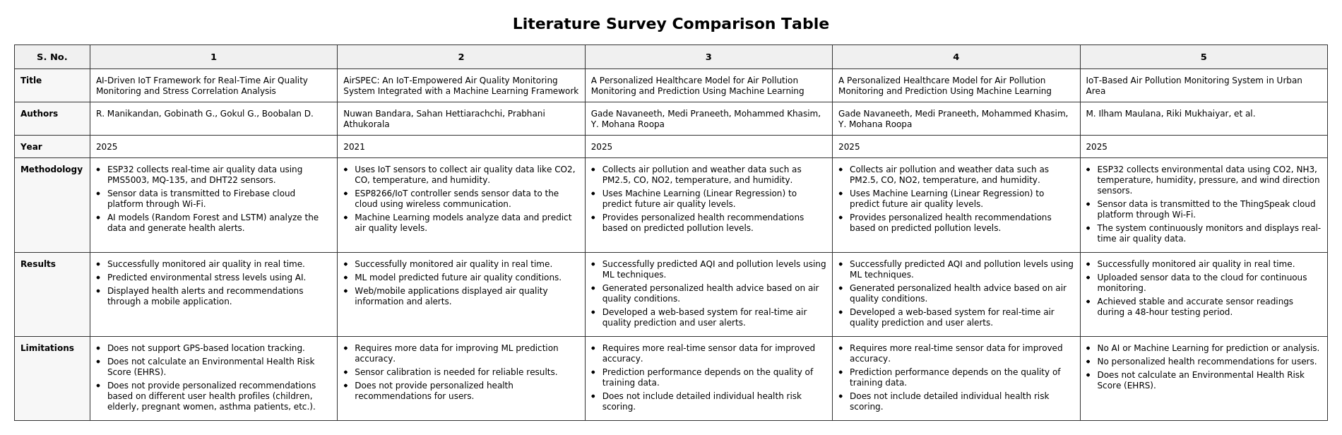

Slide 5
PROPOSED METHODOLOGY:
The proposed system uses an IoT-based environmental monitoring approach integrated with Artificial Intelligence to provide personalized health recommendations. An ESP32 microcontroller is used to collect real-time environmental data from different sensors, including the PMS5003 sensor for measuring PM2.5 and PM10 particles, the MQ-135 gas sensor for detecting harmful gases, the DHT22 sensor for monitoring temperature and humidity, and a GPS module for location tracking. The collected sensor data is transmitted to a cloud platform through Wi-Fi for storage and processing. An AI/Machine Learning model analyzes the collected environmental data along with the user's health profile to calculate an Environmental Health Risk Score (EHRS). Based on the risk score, the system generates personalized health advisories, including safety conditions, recommended exposure duration, and preventive measures. The final air quality information, risk level, and health recommendations are displayed to users through a mobile or web application, helping individuals make informed decisions and reduce health risks caused by air pollution.

Slide 6
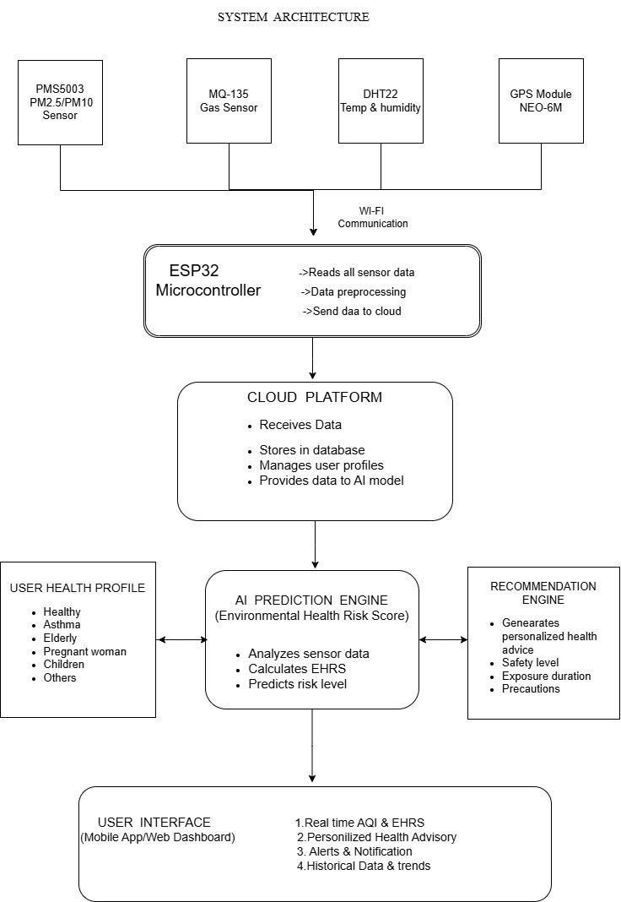
SYSTEM ARCHITECTURE :

Slide 7
Module wise implementation:-
Hardware Integration: Connects ESP32 with environmental sensors.
Data Acquisition: Collects temperature, humidity, gas, and GPS data.
Serial Communication: Transfers and processes sensor data.
Monitoring Dashboard: Displays real-time environmental readings.
Alert Management: Activates alerts for high temperature.
Data Visualization: Shows historical readings through charts.
Reports & Analytics: Generates reports and exports sensor data.

Slide 8
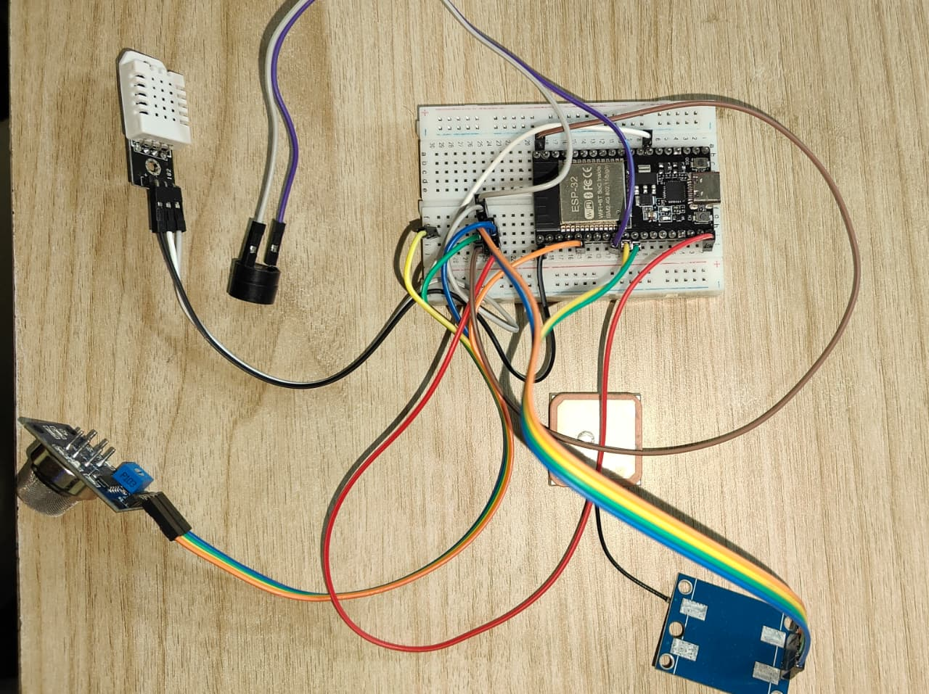
Prototype description:-
AI-powered personalized environmental health advisory system using iot is an ESP32-based prototype designed to monitor environmental parameters in real time. The system integrates DHT22 for temperature and humidity measurement, MQ-135 for gas sensing, and NEO-6M GPS for location tracking and PMS5003 . A buzzer provides hardware alerts when the temperature exceeds the programmed threshold. The collected sensor data is transmitted to a web-based dashboard for live monitoring, historical analysis, and report generation. The system is designed for future expansion with the PMS5003 particulate matter sensor.

Slide 9
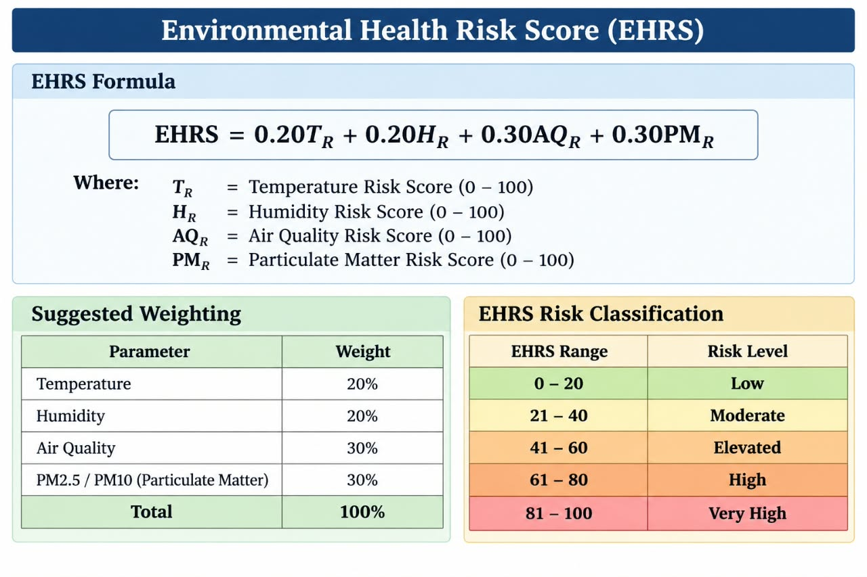
EHRS calculation:

Slide 10
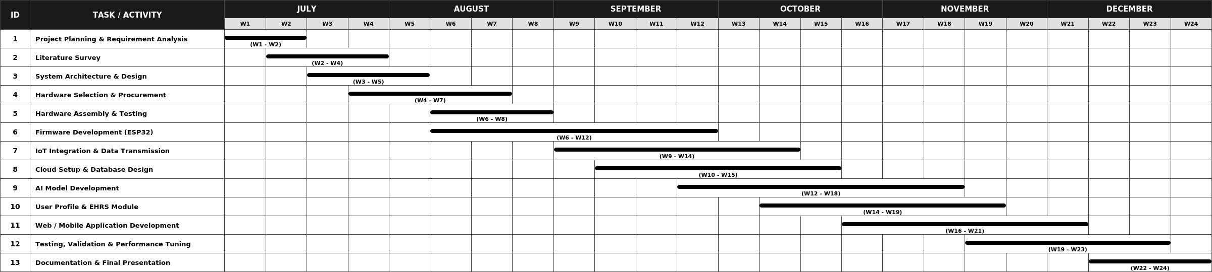
GANTT CHART :

Slide 11
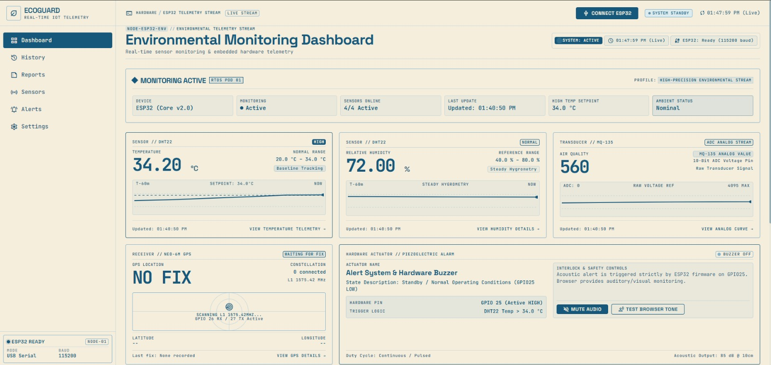
Application Dashboard:

Slide 12
Technologies Used:
HTML – Used to develop the basic structure of the web interface and organize the content, sections, forms, and information displayed to the user.
CSS – Used to design and improve the visual appearance of the interface, including the layout, spacing, fonts, buttons, colors, and overall presentation.
JavaScript – Used to add interactive functionality to the interface, handle user inputs, process required actions, and dynamically display system information..

Slide 13
Complete analysis & result :-
The system collects real-time environmental data through the IoT sensing unit.The collected data is processed to assess the user's surrounding air-quality conditions.An Environmental Health Risk Score (EHRS) is calculated to represent the overall level of environmental health risk.The EHRS is classified into Low, Moderate, Elevated, High, and Very High risk categories.GPS information provides location context for the environmental assessment.The user's health profile is considered to generate more personalized health guidance.The proposed system combines environmental monitoring, risk assessment, and personalized advisory within a single framework.The results demonstrate the system's ability to convert raw environmental measurements into understandable health-oriented information

Slide 14
THANK
YOU

